Slide 1
Health Information System - By Stephen Kinyanjui

Slide 2
The challenge
The task was to build a system where doctors can manage clients and health programs.
Required features:
1. Create health programs
2. Register clients & enroll them into health programs
3. Search & View client profiles and health programs
4. Expose client profiles using an API

Slide 3
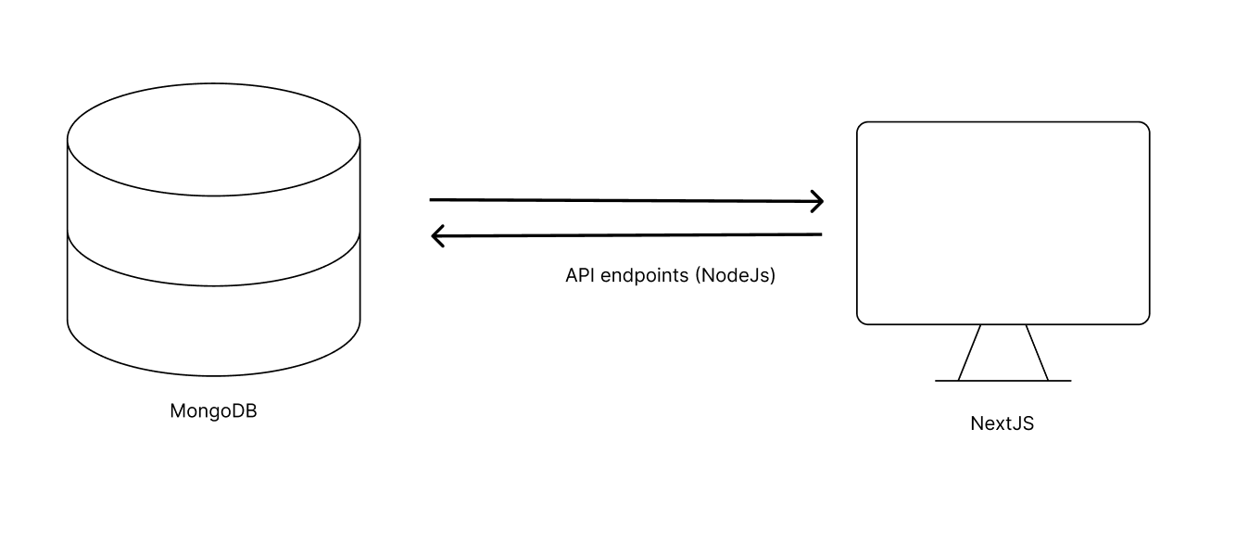
System Design
Technologies used:
Frontend & Server: Next.js
Database : MongoDB

Slide 4
System Design
Database setup
1. Programs (health programs)
- _id ( ObjectId )
- name ( String )
-createdAt ( Date )
2. Clients
- _id ( ObjectId )
- name ( String )
- age ( Int )
-weight ( Int )
-height ( Int )
-registered_at ( Date )

Slide 5
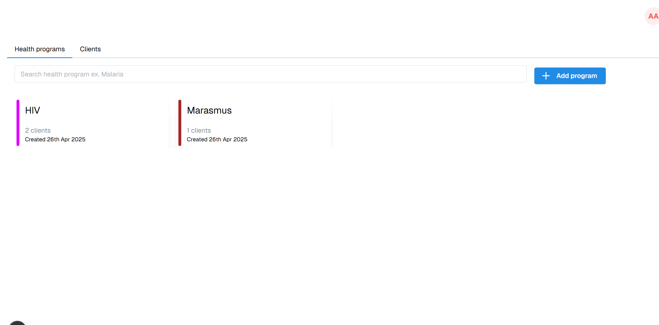
Solution
Initial page of the system , showing a tab view with health programs and registered clients.

Slide 6
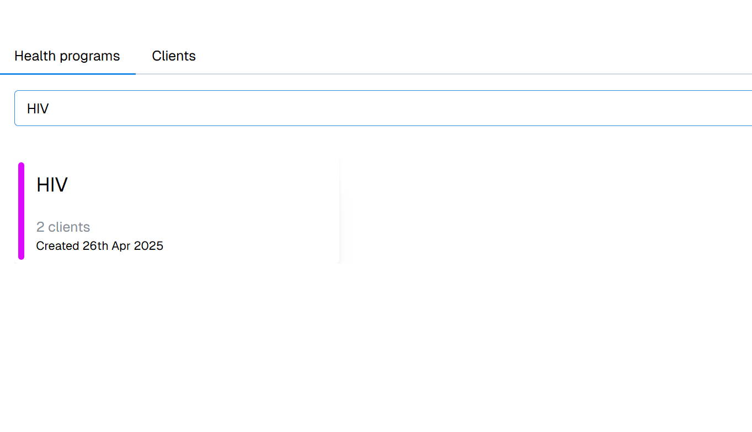
Solution
System users can search for health programs by typing in the search field

Slide 7
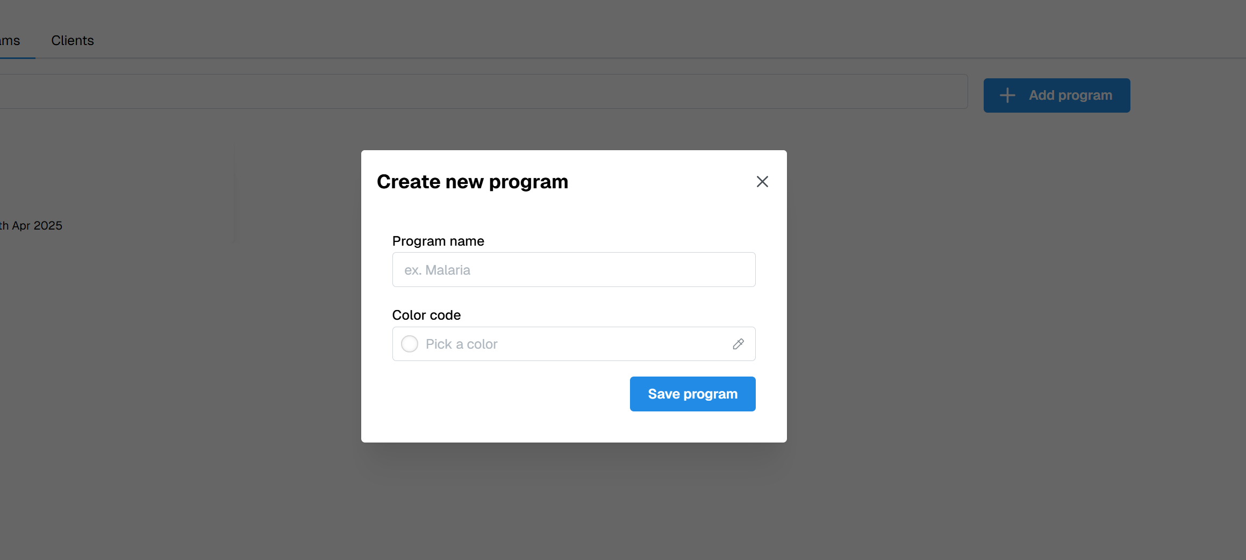
Solution
System users can also create new program by clicking the “Add new program” button

Slide 8
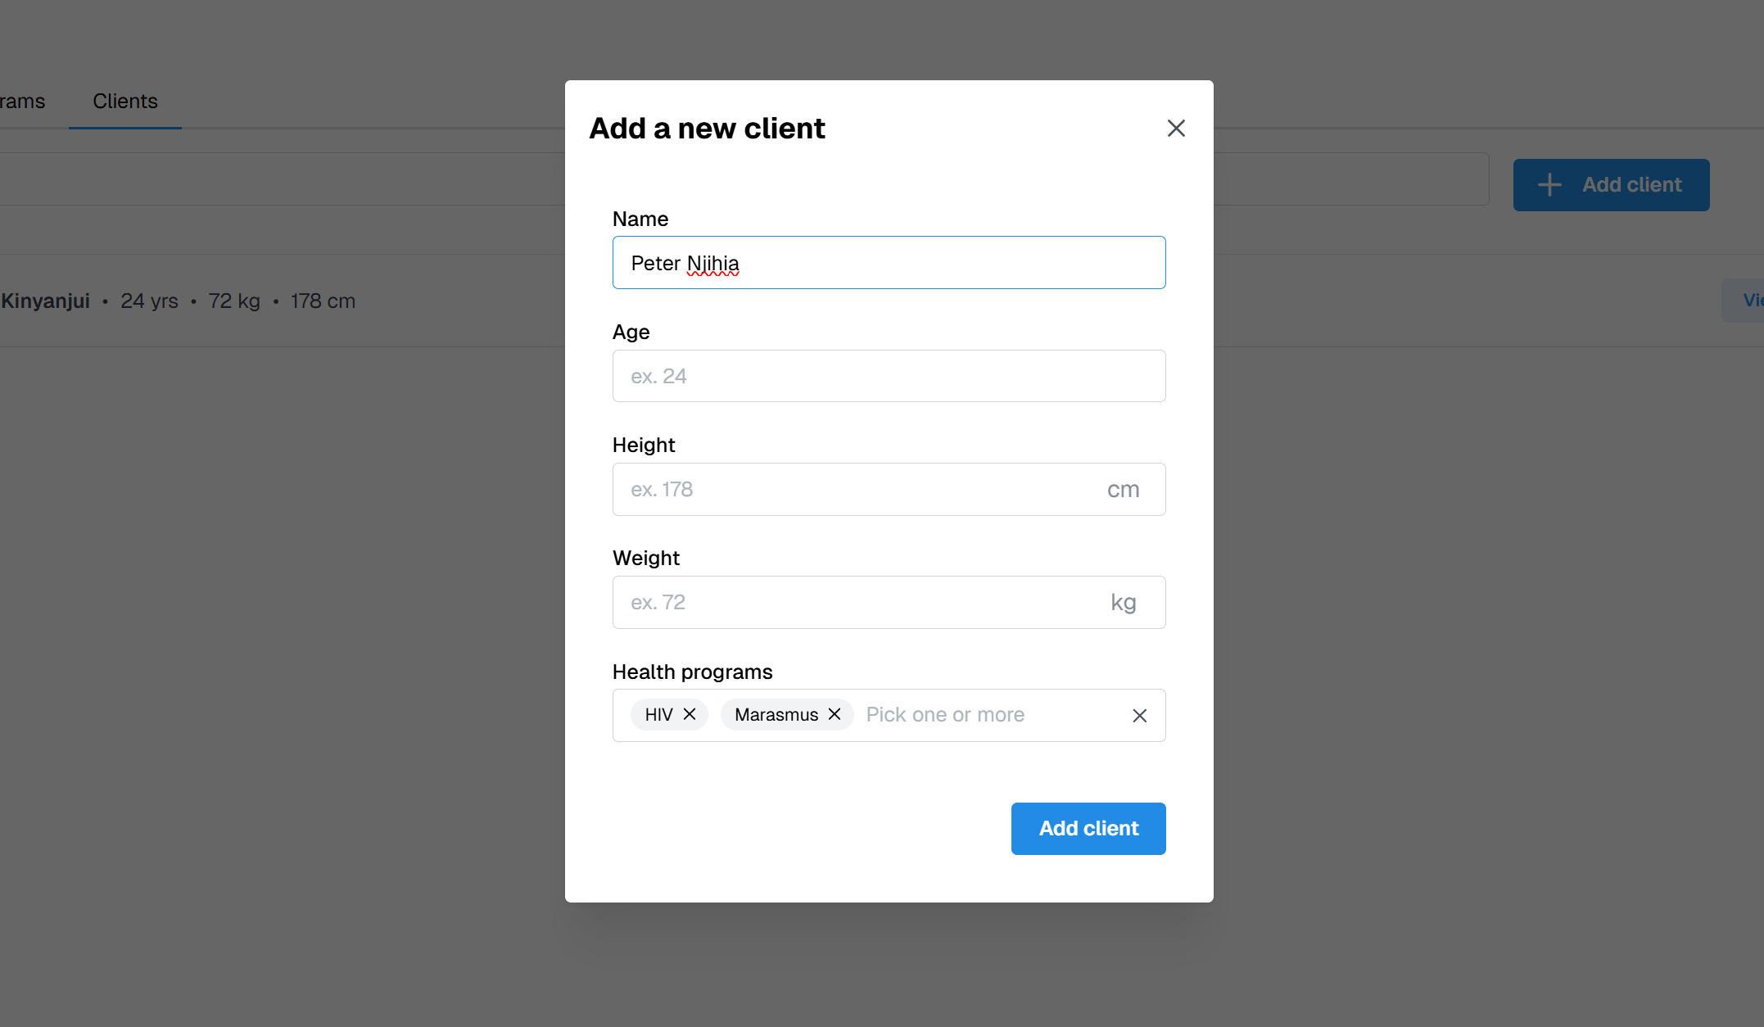
Solution
System users can also register clients and enroll them to existing programs.

Slide 9
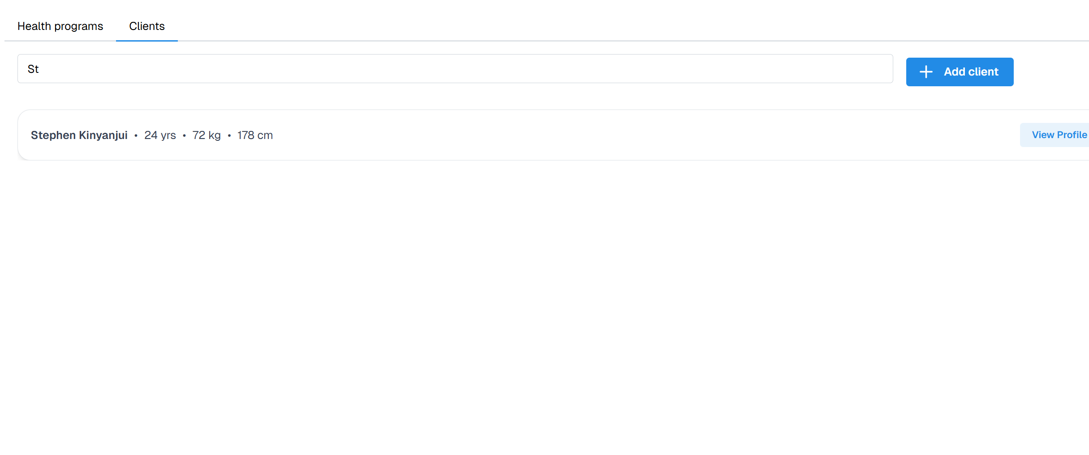
Solution
System users can also view and search registered clients by going to the clients’ tab

Slide 10
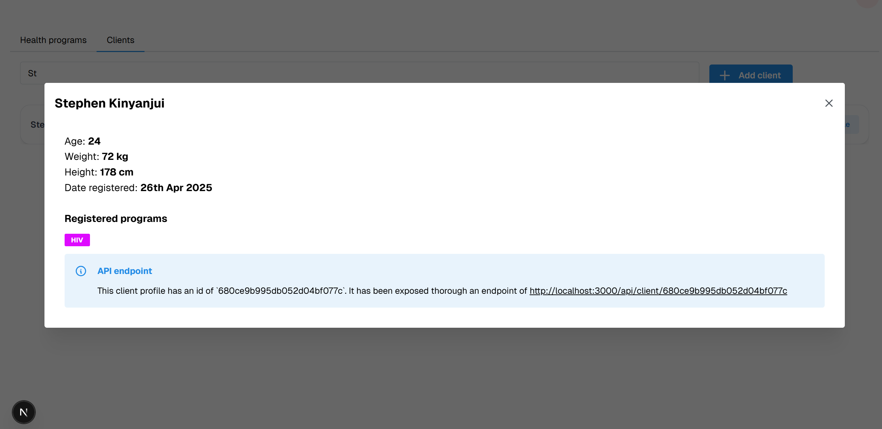
Solution
System users can also go to a client’s profile and also see the programs they are enrolled in.

Slide 11
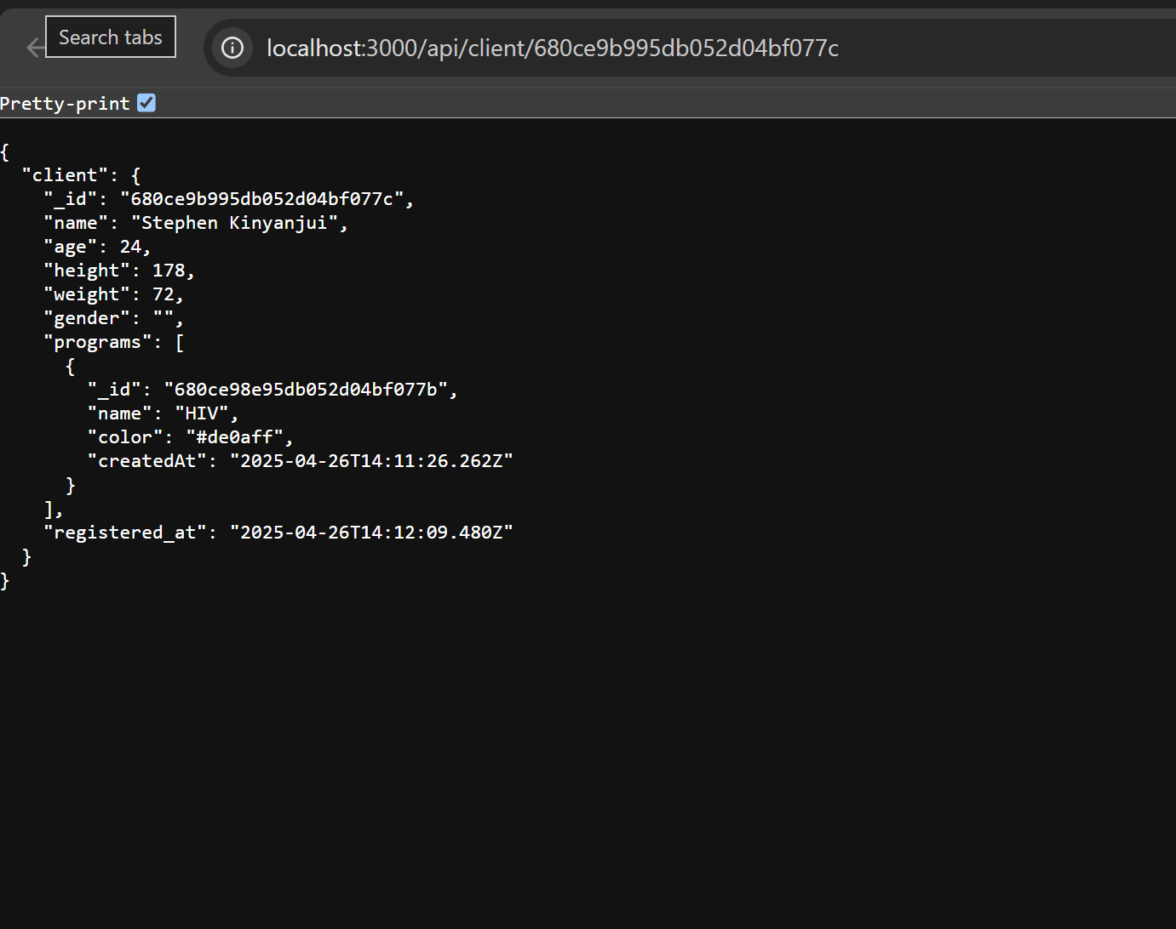
Solution
The system also exposes a client profile API that allows to interconnection with other systems.

Slide 12
Conclusion
Overally , the system performs as required.
Here is the link of where it has been deployed: https://cema-project.vercel.app/

